Slide 1
Technologia
Imagine you are a citizen of Technologia, a country that produces two goods:
Smartphones
Tablet computers
What do these two goods have in common?
Both digital technology
Both wireless
Both have touch screens

Slide 2
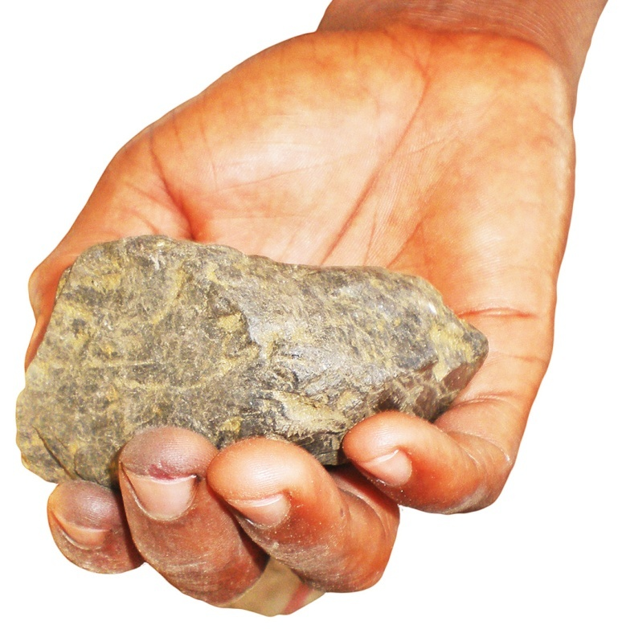
Coltan
Coltan is a heat-resistant ore that can hold a strong electrical charge and is used in making the capacitors needed to produce touch screens for both smartphones and tablet computers.
Coltan is rare. Almost all the deposits are found in African countries such as the Democratic Republic of Congo.
Source: University of Waterloo Earth Sciences Museum (http://www.uwaterloo.ca/earth-sciences-museum)

Slide 3
Technologia’s PPF
Simulation of smartphone/tablet production
Five students per team; each person can handle only one card at a time.
Pull card from “coltan” box.
Turn card to appropriate side.
Pass to next person.
Place in box with appropriate label.
Repeat until coltan runs out.

Slide 4
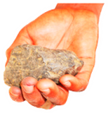
Technologia’s PPF Simulation

Slide 5
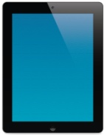
Technologia’s PPF Simulation
First person pulls a card and turns it to “Tablet”

Slide 6
Technologia’s PPF Simulation
Passes the card down the line …

Slide 7
Table 1.1: Smartphone and Tablet Computer Production Possibilities
Round (point) | Number of smartphones | Number of tablet computers
1 (A)
2 (B)
3 (C)
4 (D)
5 (E)
6 (F)

Slide 8
Technologia’s PPF
Smartphones
Tablets

Slide 9
Technologia’s PPF
Increase in the amount of coltan available for production
PPF shifts “out,” away from the origin
Smartphones
Tablets

Slide 10
Technologia’s PPF
Increase in productivity for smartphones
One unit of coltan can produce two smartphones
PPF has shifted outward, away from origin
Smartphones
Tablets

